Slide 1


Slide 2


Slide 3

12
CHAPTER
Aggregate Demand
and Aggregate
Supply Analysis
There is usually a close relationship between fluctuations in FedEx’s business and fluctuations
in GDP.
Prepared by:
Fernando Quijano

Slide 4
12
CHAPTER
Chapter Outline and
Learning Objectives
12.1 | Aggregate Demand Identify the determinants of aggregate demand and distinguish between a movement along the aggregate demand curve and a shift of the curve.
12.2 | Aggregate Supply Identify the determinants of aggregate supply and distinguish between a movement along the short-run aggregate supply curve and a shift of the curve.
12.3 | Macroeconomic Equilibrium in the Long Run and the Short Run Use the aggregate demand and aggregate supply model to illustrate the difference between short-run and long-run macroeconomic equilibrium.
12.4 | A Dynamic Aggregate Demand and Aggregate Supply Model Use the dynamic aggregate demand and aggregate supply model to analyze macroeconomic conditions.
Appendix: Macroeconomic Schools of Thought Understand macroeconomic schools of thought.
Aggregate Demand
and Aggregate
Supply Analysis

Slide 5
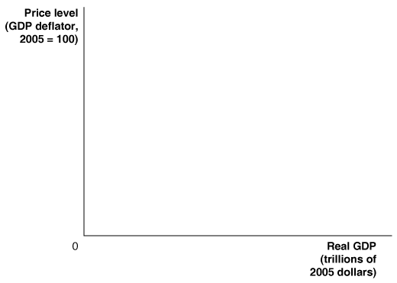
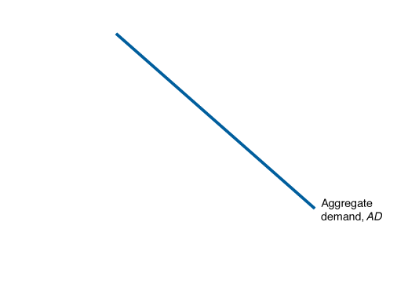
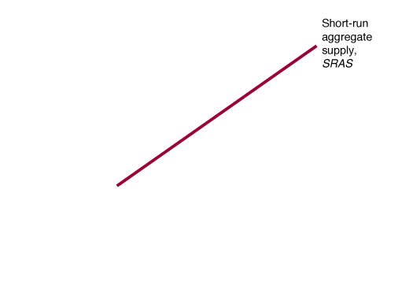
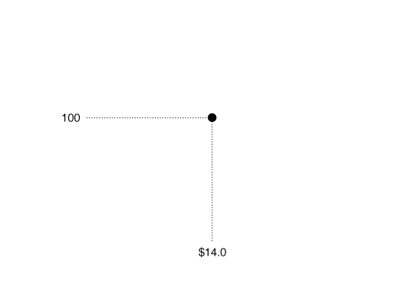
Aggregate Demand
12.1 LEARNING OBJECTIVE
Identify the determinants of aggregate demand and distinguish between a movement along the aggregate demand curve and a shift of the curve.
Aggregate demand and aggregate supply model A model that explains short-run fluctuations in real GDP and the price level.
FIGURE 12-1
Aggregate Demand and Aggregate Supply
In the short run, real GDP and the price level are determined by the intersection of the aggregate demand curve and the short-run aggregate supply curve.
In the figure, real GDP is measured on the horizontal axis, and the price level is measured on the vertical axis by the GDP deflator.
In this example, the equilibrium real GDP is $14.0 trillion, and the equilibrium price level is 100.

Slide 6
Aggregate Demand
12.1 LEARNING OBJECTIVE
Identify the determinants of aggregate demand and distinguish between a movement along the aggregate demand curve and a shift of the curve.
Aggregate demand curve A curve that shows the relationship between the price level and the quantity of real GDP demanded by households, firms, and the government.
Short-run aggregate supply curve A curve that shows the relationship in the short run between the price level and the quantity of real GDP supplied by firms.

Slide 7
Aggregate Demand
12.1 LEARNING OBJECTIVE
Identify the determinants of aggregate demand and distinguish between a movement along the aggregate demand curve and a shift of the curve.
Why Is the Aggregate Demand Curve
Downward Sloping?
GDP has four components: consumption (C), investment (I), government purchases (G), and net exports (NX). If we let Y stand for GDP, we can write the following:
Y = C + I + G + NX
The Wealth Effect: How a Change in the Price Level Affects Consumption
The impact of the price level on consumption is called the wealth effect.

Slide 8
Aggregate Demand
12.1 LEARNING OBJECTIVE
Identify the determinants of aggregate demand and distinguish between a movement along the aggregate demand curve and a shift of the curve.
Why Is the Aggregate Demand Curve
Downward Sloping?
The Interest-Rate Effect: How a Change in the Price Level Affects Investment
The impact of the price level on investment is known as the interest-rate effect.
The International-Trade Effect: How a Change in the Price Level Affects Net Exports
The impact of the price level on net exports is known as the international-trade effect.

Slide 9
Aggregate Demand
12.1 LEARNING OBJECTIVE
Identify the determinants of aggregate demand and distinguish between a movement along the aggregate demand curve and a shift of the curve.
Shifts of the Aggregate Demand Curve
versus Movements Along It
An important point to remember is that the aggregate demand curve tells us the relationship between the price level and the quantity of real GDP demanded, holding everything else constant.

Slide 10
Aggregate Demand
12.1 LEARNING OBJECTIVE
Identify the determinants of aggregate demand and distinguish between a movement along the aggregate demand curve and a shift of the curve.
The Variables That Shift the
Aggregate Demand Curve
The variables that cause the aggregate demand curve to shift fall into three categories:
• Changes in government policies
• Changes in the expectations of households and firms
• Changes in foreign variables
Don’t Let This Happen to YOU!
Understand Why the Aggregate Demand Curve Is Downward Sloping
  YOUR TURN: Test your understanding by doing related problem 1.5 at the end of this chapter.

Slide 11
Aggregate Demand
12.1 LEARNING OBJECTIVE
Identify the determinants of aggregate demand and distinguish between a movement along the aggregate demand curve and a shift of the curve.
The Variables That Shift the
Aggregate Demand Curve
Changes in Government Policies
Monetary policy The actions the Federal Reserve takes to manage the money supply and interest rates to pursue macroeconomic policy objectives.
Fiscal policy Changes in federal taxes and purchases that are intended to achieve macroeconomic policy objectives.

Slide 12
Aggregate Demand
12.1 LEARNING OBJECTIVE
Identify the determinants of aggregate demand and distinguish between a movement along the aggregate demand curve and a shift of the curve.
The Variables That Shift the
Aggregate Demand Curve
Changes in the Expectations of Households and Firms
If households become more optimistic about their future incomes, they are likely to increase their current consumption.
Changes in Foreign Variables
If firms and households in other countries buy fewer U.S. goods or if firms and households in the United States buy more foreign goods, net exports will fall, and the aggregate demand curve will shift to the left.

Slide 13
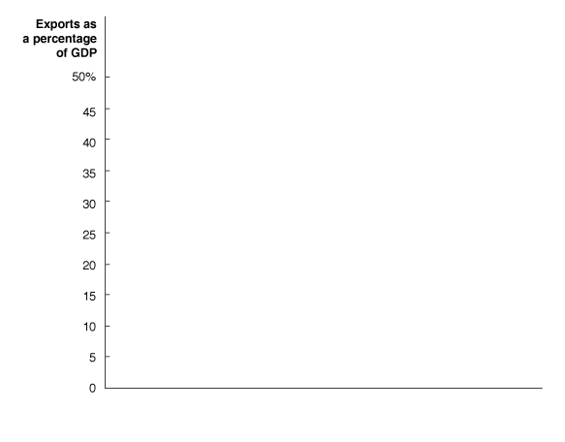
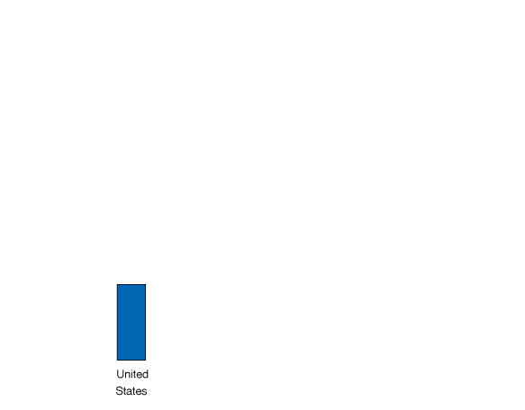
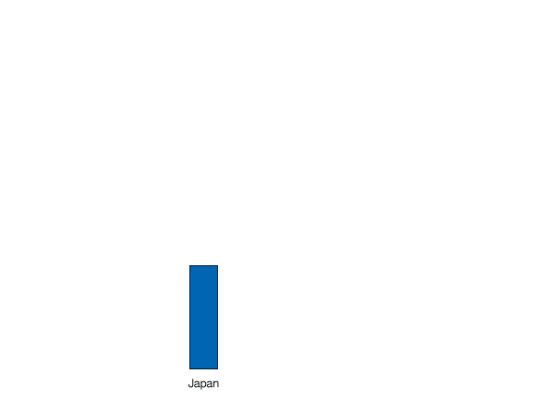
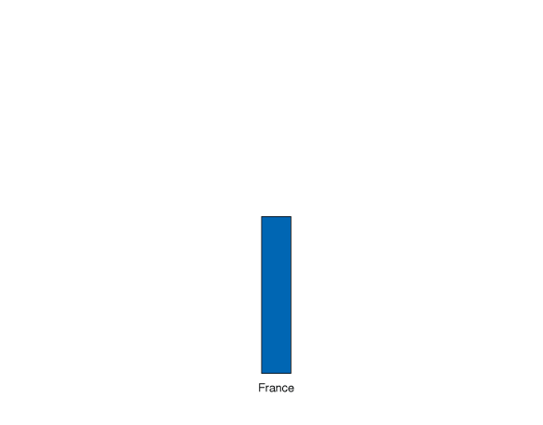
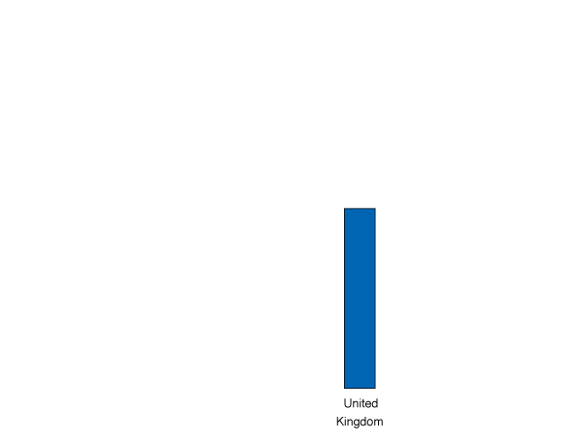
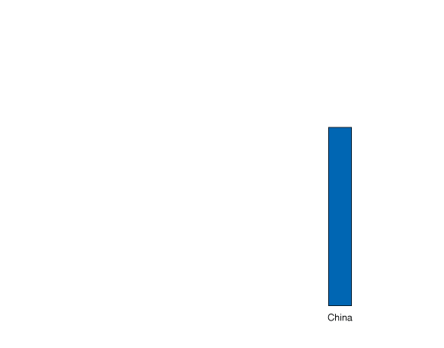
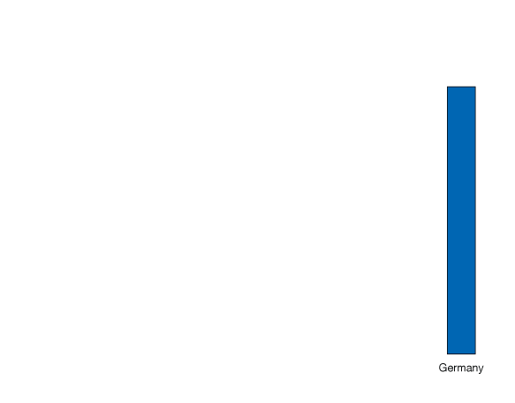

Making
the
Connection
12.1 LEARNING OBJECTIVE
Should Germany Reduce
Its Reliance on Exports?
Identify the determinants of aggregate demand and distinguish between a movement along the aggregate demand curve and a shift of the curve.
The decline in German exports during the 2007–2009 recession was bad news for German workers.
  YOUR TURN: Test your understanding by doing related problem 1.7 at the end of this chapter.

Slide 14

Learning Objective 12.1
Making
the
Connection
In a Global Economy, How Can You Tell
the Imports from the Domestic Goods?
Is the Toyota Sienna as American as apple pie?

Slide 15
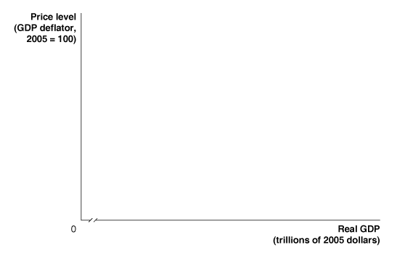
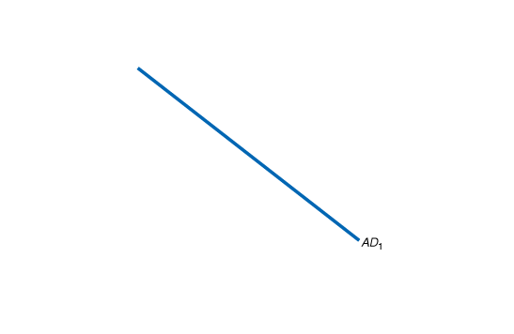
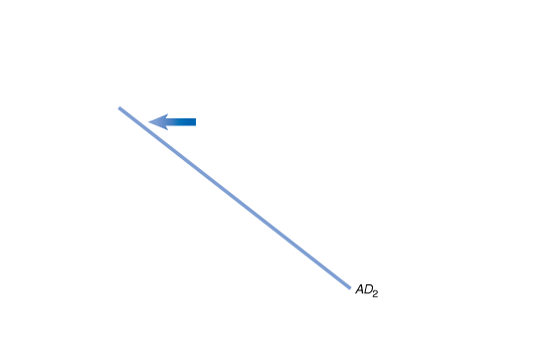

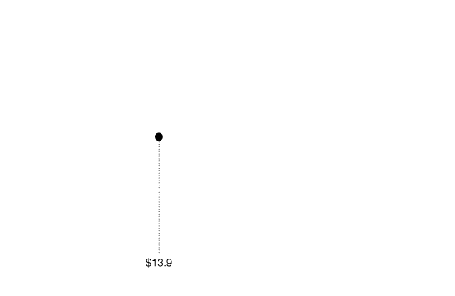
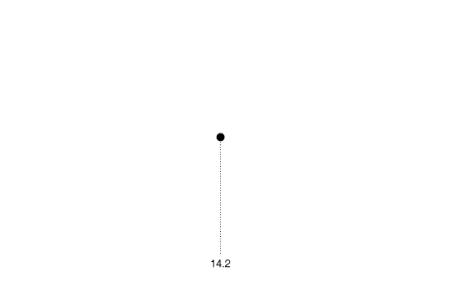

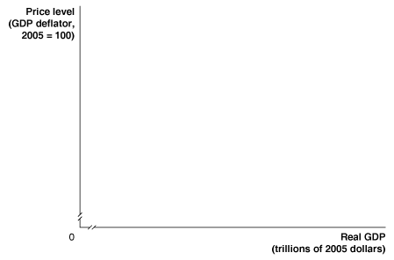
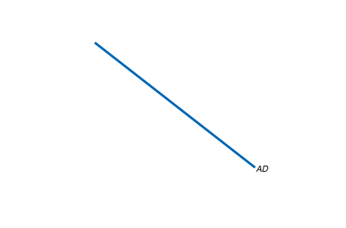
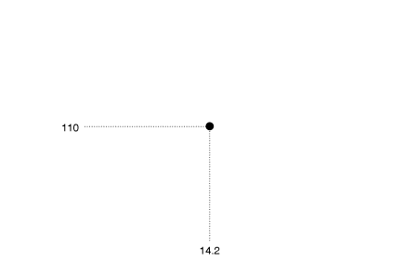
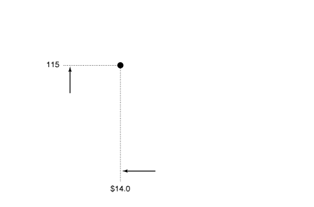
12.1 LEARNING OBJECTIVE
Solved Problem
12-1
Identify the determinants of aggregate demand and distinguish between a movement along the aggregate demand curve and a shift of the curve.
Movements along the Aggregate Demand Curve
versus Shifts of the Aggregate Demand Curve
  YOUR TURN: For more practice, do related problem 1.6 at the end of this chapter.

Slide 16

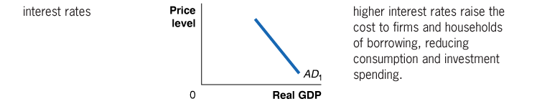
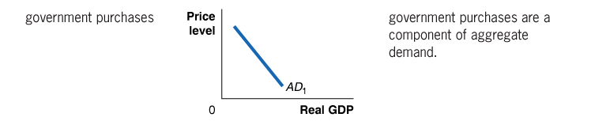

Aggregate Demand
12.1 LEARNING OBJECTIVE
Identify the determinants of aggregate demand and distinguish between a movement along the aggregate demand curve and a shift of the curve.
The Variables That Shift the
Aggregate Demand Curve
Table 12-1
Variables That Shift the Aggregate Demand Curve

Slide 17
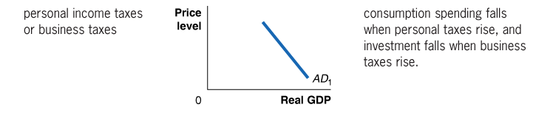

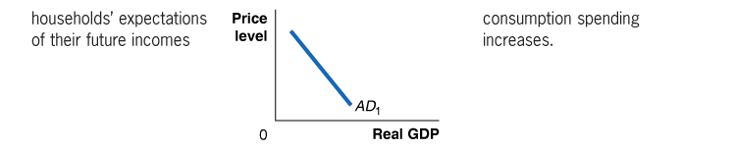

Aggregate Demand
12.1 LEARNING OBJECTIVE
Identify the determinants of aggregate demand and distinguish between a movement along the aggregate demand curve and a shift of the curve.
The Variables That Shift the
Aggregate Demand Curve
Table 12-1
Variables That Shift the Aggregate Demand Curve (continued)

Slide 18
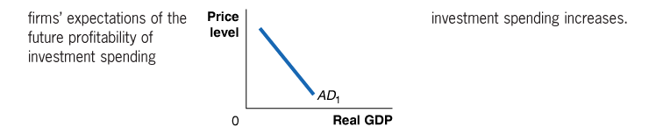

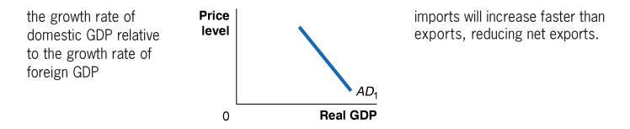

Aggregate Demand
12.1 LEARNING OBJECTIVE
Identify the determinants of aggregate demand and distinguish between a movement along the aggregate demand curve and a shift of the curve.
The Variables That Shift the
Aggregate Demand Curve
Table 12-1
Variables That Shift the Aggregate Demand Curve (continued)

Slide 19
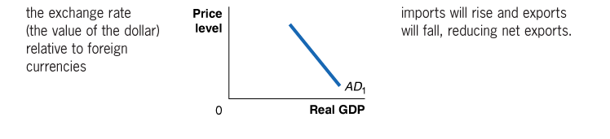

Aggregate Demand
12.1 LEARNING OBJECTIVE
Identify the determinants of aggregate demand and distinguish between a movement along the aggregate demand curve and a shift of the curve.
The Variables That Shift the
Aggregate Demand Curve
Table 12-1
Variables That Shift the Aggregate Demand Curve (continued)

Slide 20
Aggregate Supply
12.2 LEARNING OBJECTIVE
Identify the determinants of aggregate supply and distinguish between a movement along the short-run aggregate supply curve and a shift of the curve.
The Long-Run Aggregate Supply Curve
Long-run aggregate supply curve A curve that shows the relationship in the long run between the price level and the quantity of real GDP supplied.

Slide 21
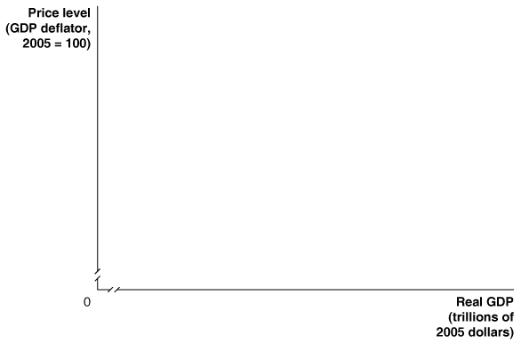
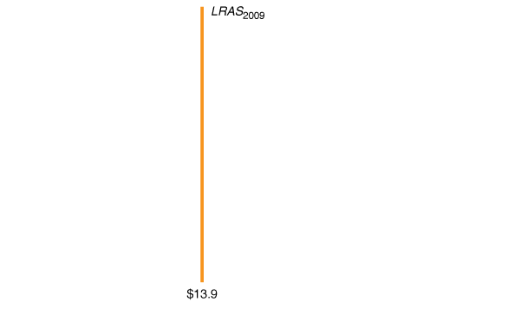

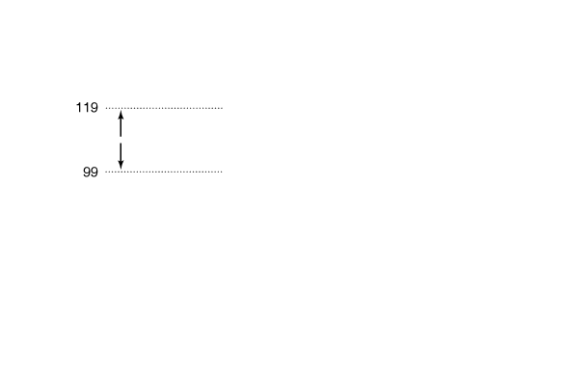
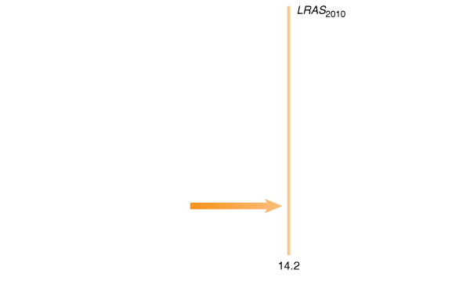
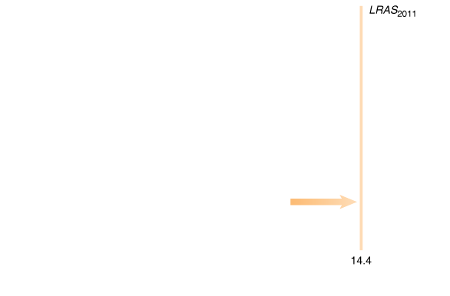
Aggregate Supply
12.2 LEARNING OBJECTIVE
Identify the determinants of aggregate supply and distinguish between a movement along the short-run aggregate supply curve and a shift of the curve.
The Long-Run Aggregate Supply Curve
FIGURE 12-2
The Long-Run Aggregate
Supply Curve
Changes in the price level do not affect the level of aggregate supply in the long run. Therefore, the long-run aggregate supply curve, labeled LRAS, is a vertical line at the potential level of real GDP.
For instance, the price level was 109 in 2009, and potential real GDP was $13.9 trillion.
If the price level had been 119, or if it had been 99, long-run aggregate supply would still have been a constant $13.9 trillion.
Each year, the long-run aggregate supply curve shifts to the right, as the number of workers in the economy increases, more machinery and equipment are accumulated, and technological change occurs.

Slide 22
Aggregate Supply
12.2 LEARNING OBJECTIVE
Identify the determinants of aggregate supply and distinguish between a movement along the short-run aggregate supply curve and a shift of the curve.
The Short-Run Aggregate Supply Curve
The three most common explanations as to why a short-run aggregate supply curve slopes upward include:
Contracts make some wages and prices “sticky.”
Firms are often slow to adjust wages.
Menu costs make some prices sticky.
Menu costs The costs to firms of changing prices.

Slide 23
Aggregate Supply
12.2 LEARNING OBJECTIVE
Identify the determinants of aggregate supply and distinguish between a movement along the short-run aggregate supply curve and a shift of the curve.
Shifts of the Short-Run Aggregate Supply Curve versus Movements along It
It is important to remember the difference between a shift in a curve and a movement along a curve.
Variables That Shift the Short-Run Aggregate Supply Curve
Increases in the Labor Force and in the Capital Stock
Technological Change
Expected Changes in the Future Price Level

Slide 24
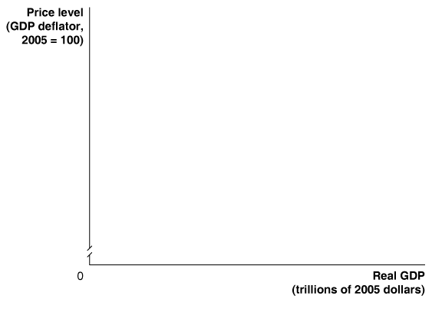
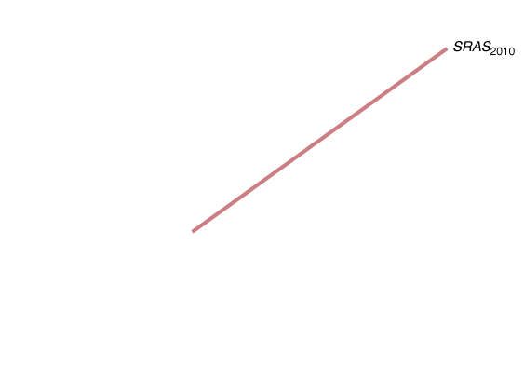
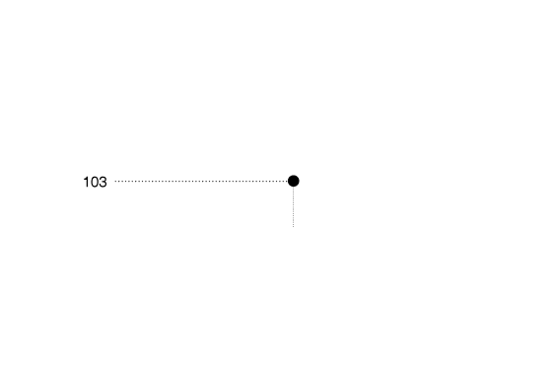
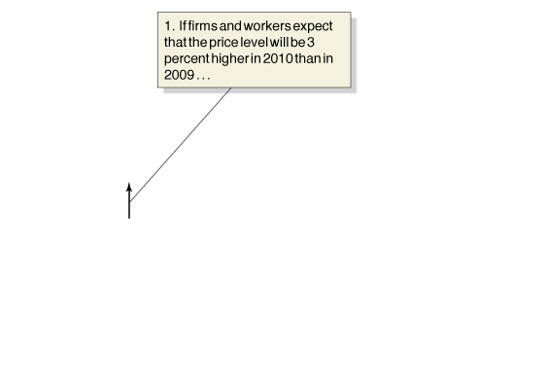
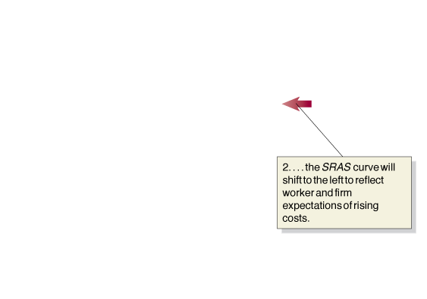
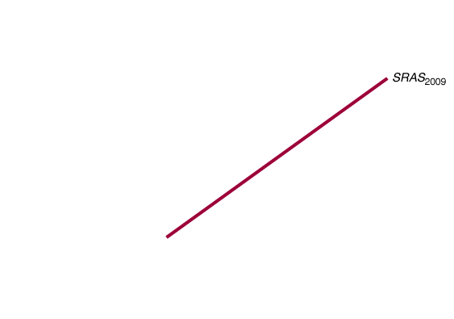
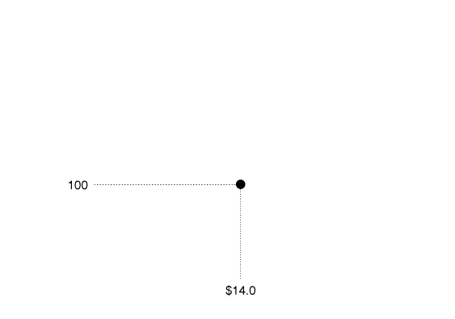
Aggregate Supply
12.2 LEARNING OBJECTIVE
Identify the determinants of aggregate supply and distinguish between a movement along the short-run aggregate supply curve and a shift of the curve.
Variables That Shift the Short-Run
Aggregate Supply Curve
Expected Changes in the Future Price Level
FIGURE 12-3
How Expectations of the Future Price Level Affect the Short-Run Aggregate Supply
The SRAS curve shifts to reflect worker and firm expectations of future prices.
1. If workers and firms expect that the price level will rise by 3 percent, from 100 to 103, they will adjust their wages and prices by that amount.
2. Holding constant all other variables that affect aggregate supply, the short-run aggregate supply curve will shift to the left.
If workers and firms expect that the price level will be lower in the future, the short-run aggregate supply curve will shift to the right.

Slide 25
Aggregate Supply
12.2 LEARNING OBJECTIVE
Identify the determinants of aggregate supply and distinguish between a movement along the short-run aggregate supply curve and a shift of the curve.
Variables That Shift the Short-Run
Aggregate Supply Curve
Adjustments of Workers and Firms to Errors in Past Expectations about the Price Level
Unexpected Changes in the Price of an Important
Natural Resource
Supply shock An unexpected event that causes the short-run aggregate supply curve to shift.

Slide 26
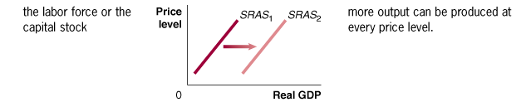
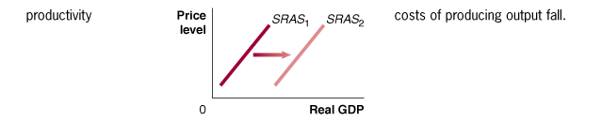
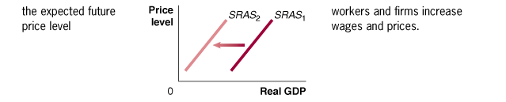
Aggregate Supply
12.2 LEARNING OBJECTIVE
Identify the determinants of aggregate supply and distinguish between a movement along the short-run aggregate supply curve and a shift of the curve.
Variables That Shift the Short-Run
Aggregate Supply Curve
Table 12-2
Variables That Shift the Short-Run Aggregate Supply Curve

Slide 27
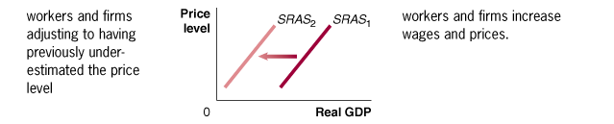
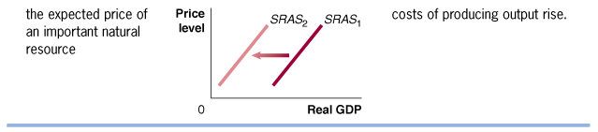
Aggregate Supply
12.2 LEARNING OBJECTIVE
Identify the determinants of aggregate supply and distinguish between a movement along the short-run aggregate supply curve and a shift of the curve.
Variables That Shift the Short-Run
Aggregate Supply Curve
Table 12-2
Variables That Shift the Short-Run Aggregate Supply Curve (continued)

Slide 28
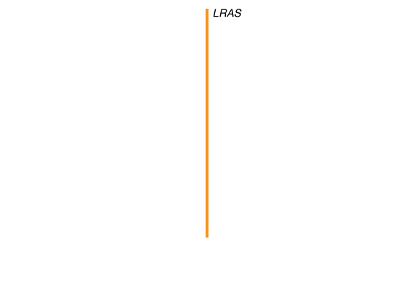
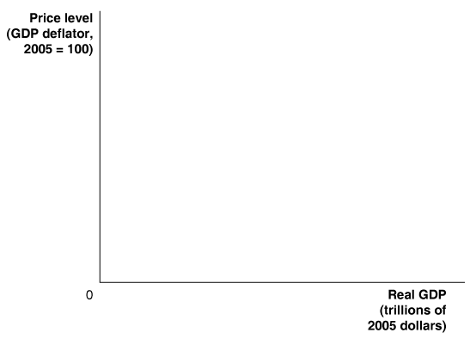
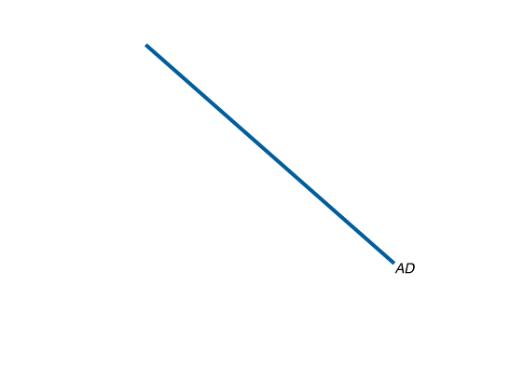
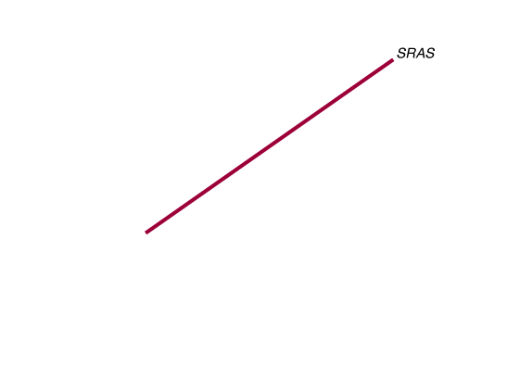
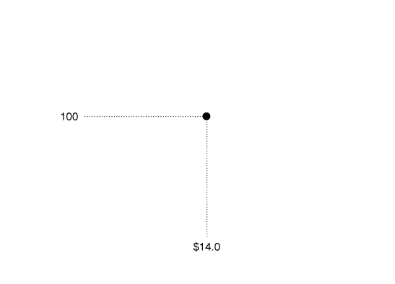
Macroeconomic Equilibrium in the Long Run and the Short Run
12.3 LEARNING OBJECTIVE
Use the aggregate demand and aggregate supply model to illustrate the difference between short-run and long-run macroeconomic equilibrium.
FIGURE 12-4
Long-Run Macroeconomic Equilibrium
In long-run macroeconomic equilibrium, the AD and SRAS curves intersect at a point on the LRAS curve.
In this case, equilibrium occurs at real GDP of $14.0 trillion and a price level of 100.

Slide 29
Macroeconomic Equilibrium in the Long Run and the Short Run
12.3 LEARNING OBJECTIVE
Use the aggregate demand and aggregate supply model to illustrate the difference between short-run and long-run macroeconomic equilibrium.
Recessions, Expansions, and Supply Shocks
Because the full analysis of the aggregate demand and aggregate supply model can be complicated, we begin with a simplified case, using two assumptions:
The economy has not been experiencing any inflation. The price level is currently 100, and workers and firms expect it to remain at 100 in the future.
The economy is not experiencing any long-run growth. Potential real GDP is $14.0 trillion and will remain at that level in the future.

Slide 30
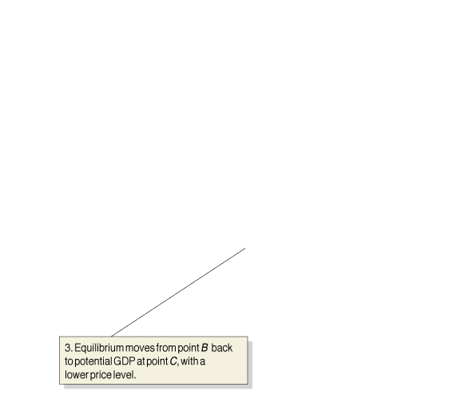













Macroeconomic Equilibrium in the Long Run and the Short Run
12.3 LEARNING OBJECTIVE
Use the aggregate demand and aggregate supply model to illustrate the difference between short-run and long-run macroeconomic equilibrium.
Recessions, Expansions, and Supply Shocks
Recession
FIGURE 12-5
The Short-Run and Long-Run Effects of a Decrease in Aggregate Demand
In the short run, a decrease in aggregate demand causes a recession.
In the long run, it causes only a decrease in the price level.

Slide 31












Making
the
Connection
12.4 LEARNING OBJECTIVE
Does It Matter What Causes
a Decline in Aggregate Demand?
Use the dynamic aggregate demand and aggregate supply model to analyze macroeconomic conditions.
The collapse in spending on housing added to the severity of the 2007–2009 recession.
Spending on residential construction has declined prior to every recession since 1955.
  YOUR TURN: Test your understanding by doing related problem 3.5 at the end of this chapter.

Slide 32














Macroeconomic Equilibrium in the Long Run and the Short Run
12.3 LEARNING OBJECTIVE
Use the aggregate demand and aggregate supply model to illustrate the difference between short-run and long-run macroeconomic equilibrium.
Recessions, Expansions, and Supply Shocks
Expansion
FIGURE 12-6
The Short-Run and Long- Run Effects of an Increase in Aggregate Demand
In the short run, an increase in aggregate demand causes an increase in real GDP.
In the long run, it causes only an increase in the price level.

Slide 33




















Macroeconomic Equilibrium in the Long Run and the Short Run
12.3 LEARNING OBJECTIVE
Use the aggregate demand and aggregate supply model to illustrate the difference between short-run and long-run macroeconomic equilibrium.
Recessions, Expansions, and Supply Shocks
Supply Shock
FIGURE 12-7
The Short-Run and Long-Run Effects of a Supply Shock
Panel (a) shows that a supply shock, such as a large increase in oil prices, will cause a recession and a higher price level in the short run. The recession caused by the supply shock increases unemployment and reduces output.
In panel (b), rising unemployment and falling output result in workers being willing to accept lower wages and firms being willing to accept lower prices. The short-run aggregate supply curve shifts from SRAS₂ to SRAS₁. Equilibrium moves from point B back to potential GDP and the original price level at point A.

Slide 34
Macroeconomic Equilibrium in the Long Run and the Short Run
12.3 LEARNING OBJECTIVE
Use the aggregate demand and aggregate supply model to illustrate the difference between short-run and long-run macroeconomic equilibrium.
Recessions, Expansions, and Supply Shocks
Supply Shock
Stagflation A combination of inflation and recession, usually resulting from a supply shock.

Slide 35

Making
the
Connection
12.3 LEARNING OBJECTIVE
How Long Does It Take to Return
to Potential GDP? A View from
the Obama Administration
Use the aggregate demand and aggregate supply model to illustrate the difference between short-run and long-run macroeconomic equilibrium.
The difficulty in predicting how much aggregate demand and aggregate supply will shift means that economists often have difficulty correctly predicting the beginning and end of recessions.
Christina Romer, the chair of the Council of Economic Advisers in the Obama Administration, provided an estimate of how long the economy would take to return to potential GDP..
  YOUR TURN: Test your understanding by doing related problem 3.8 at the end of this chapter.

Slide 36
A Dynamic Aggregate Demand and Aggregate Supply Model
12.4 LEARNING OBJECTIVE
Use the dynamic aggregate demand and aggregate supply model to analyze macroeconomic conditions.
We can create a dynamic aggregate demand and aggregate supply model by making three changes to the basic model.
• Potential real GDP increases continually, shifting the long-run aggregate supply curve to the right.
• During most years, the aggregate demand curve shifts to the right.
• Except during periods when workers and firms expect high rates of inflation, the short-run aggregate supply curve will be shifting to the right.

Slide 37
A Dynamic Aggregate Demand and Aggregate Supply Model
12.4 LEARNING OBJECTIVE
Use the dynamic aggregate demand and aggregate supply model to analyze macroeconomic conditions.
The Recession of 2007-2009
The recession began in December 2007,with the end of the economic expansion that had begun in November 2001. Several factors contributed to bring on the recession:
• The end of the housing "bubble.”
• The financial crisis
• The rapid increase in oil prices during 2008.

Slide 38
KEY TERMS
Aggregate demand and aggregate supply model
Aggregate demand curve
Fiscal policy
Long-run aggregate supply curve
Menu costs
Monetary policy
Short-run aggregate supply curve
Stagflation
Supply shock

